Slide 1
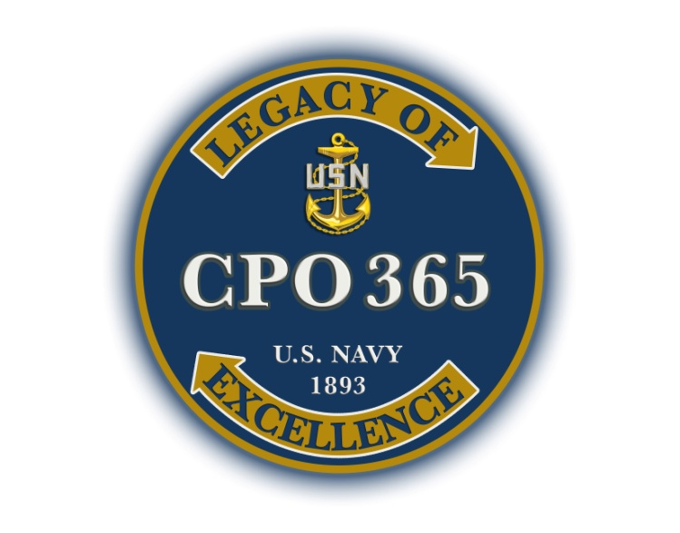
NAVY CUSTOMS, TRADITIONS AND HISTORY

Slide 2
What is the traditional meaning of each color represented on the U.S. flag?
*Red = Courage
*White = Liberty
*Blue = Loyalty

Slide 3
What is the history behind the “Don’t Tread on Me” flag?
In the fall of 1775, Commodore Esek Hopkins issued a set of fleet signals and further directed his vessels to fly a striped Jack and Ensign.
The jack-type flag originated in the 15th century by the Royal Navy.
The first U.S. Navy Jack has traditionally been shown as consisting of 13 horizontal alternating red and white stripes with a superimposed rattlesnake and the motto “Don’t Tread on Me.”
The rattlesnake represented the symbol of resistance to British repressive acts in Colonial America.

Slide 4
What are the proper procedures for disposing of a worn U.S. Ensign?
It shall not be cast aside nor used in any way that might be viewed as disrespectful.
It is to be destroyed as a whole, in private, preferably by burning.
The destruction should be complete to the extent that no part remaining is recognizable as once having been part of the national emblem.

Slide 5
What is the sequence of events for raising and lowering the National Ensign at half mast?
Raising – Hoist briskly to the peak, then lowered ceremoniously to the half-mast position.
Lowering – Hoist to the peak, then lowered.

Slide 6
Discuss the history of colors.
The Royal Navy practiced the raising and lowering of colors following the 1797 mutinies in the British fleet.
U.S. Navy adopted this practice early, but was not coded into the Rules and Regulations until 1843.
Initially, morning colors was based on the time of sunset; if the sun set before 1800, then morning colors took place at 0800, otherwise at 0900.
The modern practice of making morning colors at 0800 was set by regulation in 1870.

Slide 7
Discuss the history of “Bravo Zulu.”
Originated from the Allied Naval Signal Book (ACP 175 series), an international naval signal code adopted after NATO was created in 1949.
We know that it means “Well Done.” Prior to ACP 175, “Well Done” was signaled as “Tare Victor George (TVG)” in the U.S. phonetic alphabet at that time.
Signals were organized by general subject, starting with AA, AB, AC, and so on.
The “B” signals were called “Administrative” signals and dealt with miscellaneous matters of admin and housekeeping. The last signal on the “Administrative” page was “BZ,” standing for “Well Done.”

Slide 8
What is the purpose of U.S. Navy Battle Streamers?
Serve as symbols of the dedicated and heroic service of Sailors to the nation for more than 200 years.
Serve as reminders of the decisive influence of sea power on the establishment of the nation, and on its security and welfare through the entire period.
For each streamer, brief mention is made of the services and operations it commemorates, and the campaigns and battles for which stars are awarded.
They are 3 ft long and 2 ¾ inches wide. Where a medal has been awarded for a particular war or service, the coloring and design of the streamer are the same as the ribbon from which the medal is suspended.

Slide 9
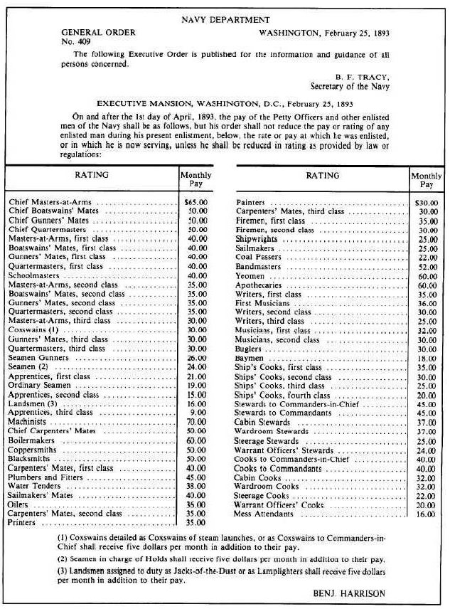
What is General Order No. 409?
Signed 25 February 1893 and affected on 1 April 1893.
Established/authorized the pay of Chief Petty Officers.
Note: In 1893, Sailors were paid based on their value to the service and NOT on their classification.

Slide 10
Origin of the 21 gun salute.
The rendering of gun salutes dates back to the early 1700’s by the Royal Navy and was customary for a ship entering a friendly port.
Salutes in odd numbers may be traced to superstition. The number seven is considered lucky and to have mystical powers. Seven gun salutes were widely used.
Officially added in 1818 to U.S. Navy regulations.
Regulation required a 21 gun salute when the President visited a U.S. Navy ship (there were 21 states at the time).
Soon added salutes to Heads of State, a “national salute” on Washington’s birthday (22 Feb) and Independence Day (4 Jul).

Slide 11
Brief history of the Commissioning Pennant.
Appear in ancient Egyptian art, medieval manuscripts and Renaissance paintings.
Late in the 17th century, all ships of the time were sailing ships and was often difficult to differentiate between a navy vessel and a merchant vessel.
Navy’s of the time adopted a commissioning pennant in some version on the national colors of its Navy.
Initially, these pennants were large, but shrank to a fraction of their early size as warships took distinctive forms and were no longer mistaken for merchant vessels.
The first Continental Navy ship, Alfred, Dec 1775.

Slide 12
Who names the ships of the U.S. Navy and when was this assigned?
Secretary of the Navy.
3 March 1819.
Why is a ship referred to as “she?”
Some objects are regarded as masculine, while others are feminine, especially those things that are dear to us. While “Mother Earth” is used to represent the common maternal parent of all life, early seafarers spoke of their ships in the feminine gender because of the close dependence they had on their ships for life and sustenance.

Slide 13
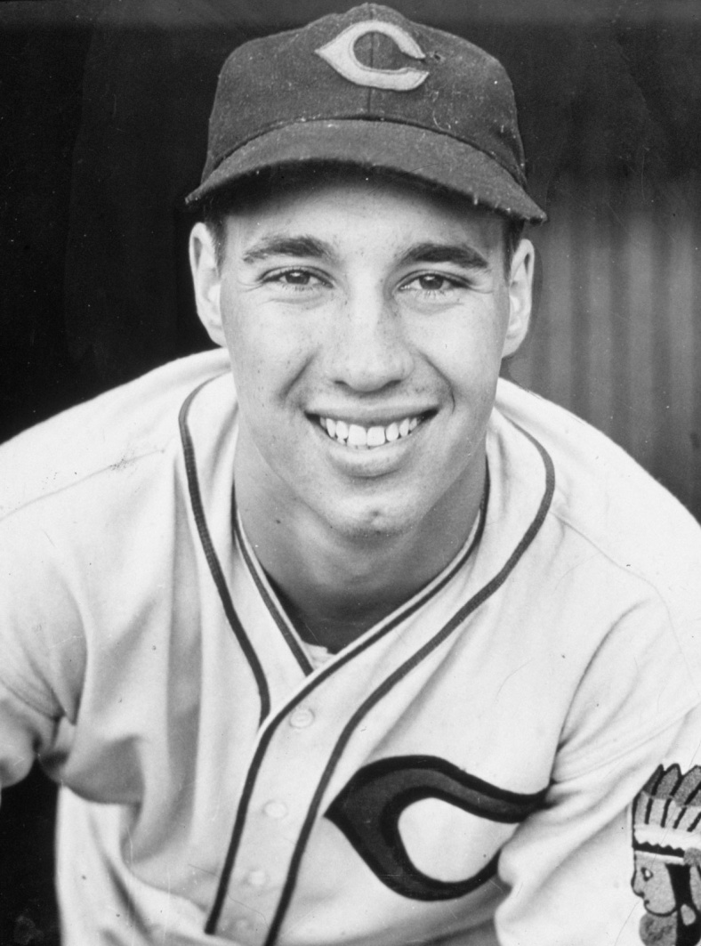
Can anyone tell me who this is, and what is significant about him?
Played baseball for the Cleveland Indians in the late 1930’s.
Nicknamed “The Heater from Van Meter.”
Served onboard USS Alabama (BB-60) seeing action off Tarawa, the Marshalls, the Carolines, and the Philippines.
Only Chief Petty Officer elected to the baseball hall of fame.
Bob Feller (Nov 1918-Dec 2010).

Slide 14
References:
NTP 13(B), Flags Pennants and Customs
http://www4.law.cornell.edu/uscode/4/ch1.html
http://mysite.verizon.net/vzeohzt4/Seaflags/customs/trads.html
http://gadsden.info/snake.html
http://www.history.navy.mil

